Slide 1
Linux Writing and compiling programs

Slide 2
Record commands as you learn them
On the last page of your notebook
Please write this at the top:
Linux Commands
On the second to last page
Please write this at the top:
vi Commands
This will help you throughout the course – because you know where to find them!
Add new commands as they are discussed in class
Don't lose it!
Important for remaining CS courses.

Slide 3
Linux/UNIX programming environment
Command line interface
Directory structure
vi editor
g++ compiler

Slide 4
Command-line interface
Run programs through text commands, rather than through mouse clicks
The “terminal” runs a command-line interpreter
Interpreter waits for a command
User enters text command
Interpreter determines activity to perform based on command
Output of activity displayed in terminal
Go back to waiting (step 1)

Slide 5
Command-line: typical format
> command_name [-flags][additional_inputs]
command_name is an executable file (an app)
-flags are special behaviors for the command. Start with a -
additional_inputs can be included
to specify special behaviors of the command
to tell the command to act on certain files
Example:
g++ -o hello.out hello.cpp

Slide 6
ToDo: From Windows Lab Computer Getting into your account on Storm
Log into the computer with your Fordham ID
Look for mobaX (icon on screen) or type in search bar (bottom left)

Slide 7
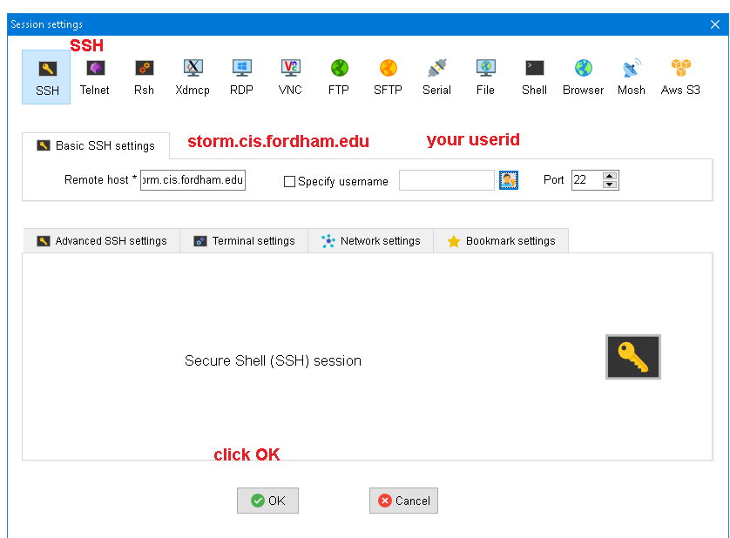
Windows: MobaXterm
Click SSH
Enter remote host
storm.cis.fordham.edu
Enter userid
Click OK
Enter & change your userID

Slide 8
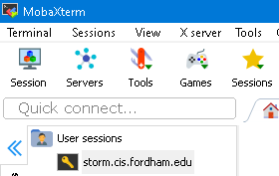
Next Time – Easy!
Click on the storm user session

Slide 9
ToDo: From Mac Lab Computer Getting into your account on Storm
Click: Student (on screen. Use password on whiteboard) 411EastFordhamRoad
On Mac : double click term (or cmd N)
then type
ssh myuserID@storm.cis.fordham.edu

Slide 10
ToDo: From YOUR Mac
On the Mac, under Documents
Make a subfolder called uploads
Open terminal
double finger click to open terminal OR terminal-/shell-> New window OR cmd N
Type:
ssh userid@storm.cis.fordham.edu
Enter your given password. Remember your changed password

Slide 11
Getting Around in linux

Slide 12
Directory structure
Files are stored in directories in your computer. We will store our C++ code and executable files on the computer storm.cis.fordham.edu
Directories can contain other directories within them
/
home
students
amy
chuck
zoe
cs1
lab1
lab2
lab3

Slide 13
Directory structure
/
zoe is a subdirectory of students
The “full path” of lab1 is:
/home/students/amy/cs1/lab1
home
students
amy
chuck
zoe
cs1
lab1
lab2
lab3

Slide 14
Practice Key Linux commands
Logging into storm
ssh username@storm.cis.fordham.edu
Show name of current directory (“print working directory”)
pwd
List contents of current directory
ls
Make new directory
mkdir newDirectoryName
Change directory
cd DirectoryName

Slide 15
ToDo: Make Directories
ls // list files in this directory
pwd // print working directory
(current directory)
ls –als // show details about the files
mkdir cs1
cd cs1
pwd
mkdir lab1
cd lab1
pwd

Slide 16
Editing in vi
vi is a very simple text editor that runs in two modes
Command Mode
Edit Mode
In edit mode: type in & change all the text you want in your file
In command mode: save your file and exit

Slide 17
Editing in vi
Type “i”
Command mode
Edit
mode
:w Save file
:q Exit vi (no save)
:wq write & then quit
Press Esc button
You can use the arrow keys, but not the mouse.
There are many other vi commands.

Slide 18
ToDo: Create file called hello.cpp
vi hello.cpp capitalization matters!
Toggle between 'insert mode' and 'command mode'
i insert characters
escape (stop inserting, enter command mode)
:w write (save) file
:q quit (no save)

Slide 19
Vim is similar to vi
Arrow keys also work
Helpful:
Note whether it says ‘--Input—’ at the bottom of the screen

Slide 20
Our first program: “Hello world!”
Create file named hello.cpp
// include library of standard input and output commands
#include <iostream>
using namespace std;
int main()
{ // Begin main function
cout << "Hello world!\n"; // output "Hello world!“
return 0; /* indicate successful
program completion */
} // End main function

Slide 21
Let's compile!
g++ hello.cpp
By default, the system creates an executable called a.out in the current directory (.)
Type:
ls
And you will see the new file!

Slide 22
Let's run it!
To run it type:
./a.out
Interaction with terminal
> g++ hello.cpp
> ./a.out
Hello world!
>

Slide 23
Compiler
Converts a file of text…
… to a program (App)
Ours compiler is called: g++
g++ hello.cpp
Generates an executable app called a.out

Slide 24
Compiler
If you want a different executable name:
g++ -o AppName hello.cpp
Now the generated executable is AppName rather than a.out
Run it with: ./AppName

Slide 25
Common Pattern of Commands
Logging into storm username@storm.cis.fordham.edu
Opening a new file to write
vi myProgram.cpp
Compiling a program – converting from text to code
g++ myProgram.cpp
Running a program
./a.out
There are many other Linux commands. I highly recommend you use my list of commands online

Slide 26
Additional Linux Commands
!! Repeat last command
!v Repeat last command that starts with v
cd .. Move up one directory level
. Shorthand for current directory
cat <filename> Print filename to the screen**
Example:
cat hello.cpp
** Yes, some command names seem to have been invented by Dr. Seuss! This one is short for concatenate (connect) multiple files (and print them to the screen)

Slide 27
Transfer files from storm to Mac
On the Mac, under Documents
Make a subfolder called uploads
double finger click to open terminal on the mac OR terminal-/shell-> New window OR cmd N

Slide 28
Mac: Assume we want to pull hello.cpp
Still on the Mac.. In the terminal window
cd Documents
pwd
cd uploads
pwd
This is your MacID destination. copy it!
Next two lines are one long command on one line with a space after scp and after .cpp
scp yourid@storm.cis.fordham.edu://home/students/yourid/cs1/lab1/hello.cpp /Users/yourid/Documents/uploads
scp yourid@storm.cis.fordham.edu://home/students/yourid/cs1/lab1/hello.cpp /Users/yourMacid/Documents/uploads
Then it asks for your password
NOW you can drag & drop this file to the autograder

Slide 29
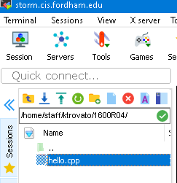

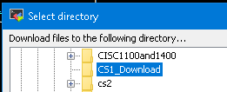
Transfer files from storm to Windows
Select the file to transfer
Click Download
Select the destination on on your PC (maybe create a directory like CS1_Download
Drag & Drop to Autograder

Slide 30
To Catch More Errors
A better way to compile:
g++ -O -Wall filename.cpp
This will give you all Warnings (like using an uninitialized variable, or declared a variable that is unused).
This might help you build better code.

Slide 31
More on Compiling
g++ myProgram.cpp –o myProgram.out
#include imports instructions from other libraries
myProgram.cpp
Compiler
myProgram object file
iostream library file
Linker
myProgram.out

